Slide 1
Advanced Systems Analysis and Design Transition from Requirements to Design SOFT 30121 L10

Slide 2
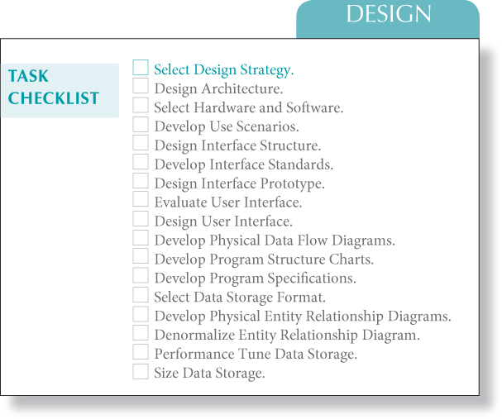
Transition from Requirements to Design
RecoSystems Analysis and Design
Alan Dennis; Barbara Haley Wixom; Roberta M. Roth
2019
Chapter 7

Slide 3
Transition from Requirements to Design
Objectives of Lecture 10
Identify and describe the steps associated with the design phase of the project.
Explain the meaning and purpose of the components of the system specification.
Explain the pros and cons of obtaining the new system through a custom development project, packaged software or outsourcing.
Explain how the characteristics of the project influence the selection of the acquisition strategy.
Explain the use of RFPs, RFIs, and RFQs as ways of gathering information from vendors.
Discuss the use of an alternatives matrix to systematically evaluate and compare alternatives.

Slide 4
Activities of the design phase
The purpose of the analysis phase is to figure out what the business needs.
System design is the determination of the overall system architecture—consisting of a set of physical processing components, hardware, software, people, and the communication among them.
During the initial part of design, the project team converts the business requirements for the system into system requirements that describe the technical details for building the system.
System requirements are communicated through a collection of design documents and physical process and data models.

Slide 5
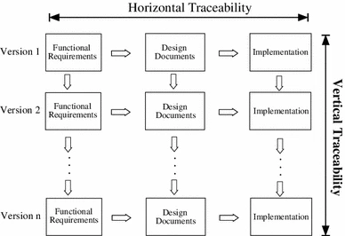
Software Design Life-Cycle (SDLC)
Within the lifetime of a software system, multiple releases and many development cycles are expected.
To manage this ongoing change of a software system, it is advantageous to have a utility that can keep the horizontal traceability between the user requirements, the design documents and the source code, while also maintaining vertical traceability along the evolutionary track of the software system.

Slide 6
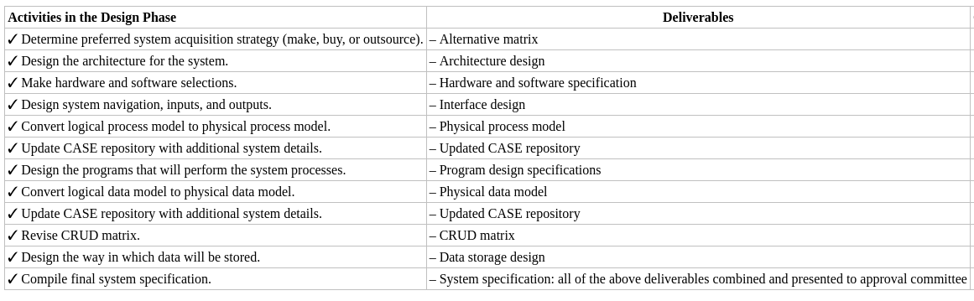
In a nutshell
The design phase has a number of activities that lead to the system blueprint.
This is a good comprehensive list and we run through a few of them in lectures. CASE tools are less popular now than they were a few years back, but fashions get recycled.

Slide 7
Nigel’s Perceptions of the Transition into Design
Formality of Design Processes
 | Really formal | Mid Ground | Really Informal | Where to put the artefacts
Is it worth building | Strategy and Analysis
What should it do | Business Requirements Document | Conceptual Prototype | Product Backlog User Stories | Requirements Business Flow
What should we build | High Level Design | Functional Spec | Wireframe | Modules Entities
How should we build it | Detailed Level Design | Technical Approach |  | Programs Tables Tech Stack
Analysis
ERP Fashionable
Microservices Fashionable
Design
1990’s
2020
Open Source Frameworks
Agile Methodologies
Use of CASE Tools

Slide 8
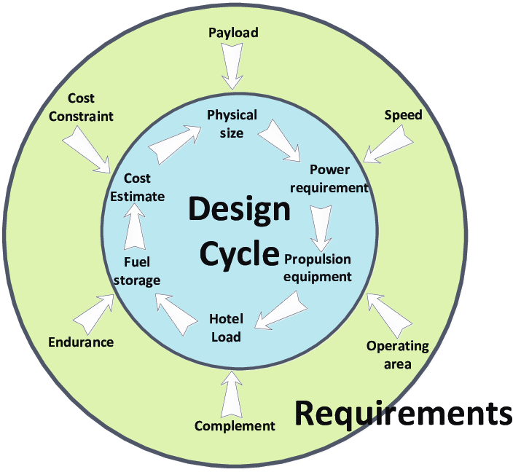
Transition from Requirements to Design
An important initial part of the design phase is the examination of several system acquisition strategies to decide which will be used to meet the requirements of the system.
Systems can be built from scratch, purchased, and customized, or outsourced to others, and the project team needs to investigate the viability of each alternative.
The decision to make, to buy, or to outsource influences the design tasks that are performed throughout the rest of the phase.

Slide 9
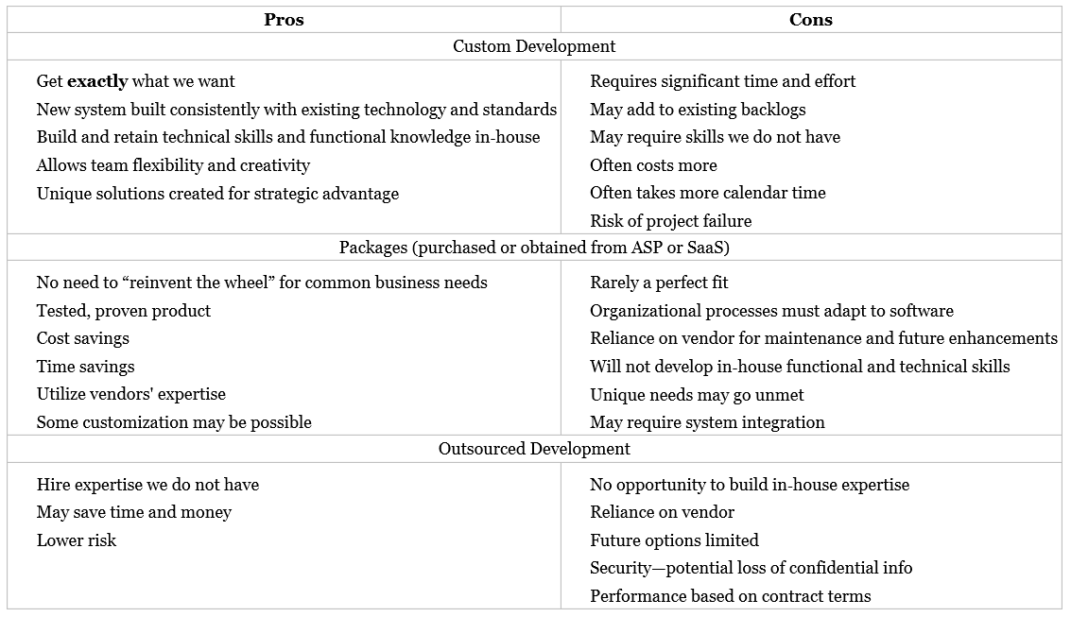
Different Acquisition Scenarios for the project

Slide 10
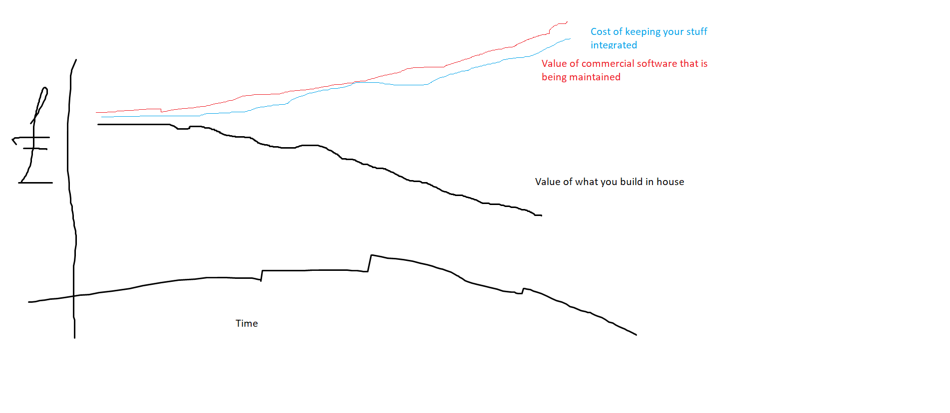
Make vs Buy things to keep in mind

Slide 11
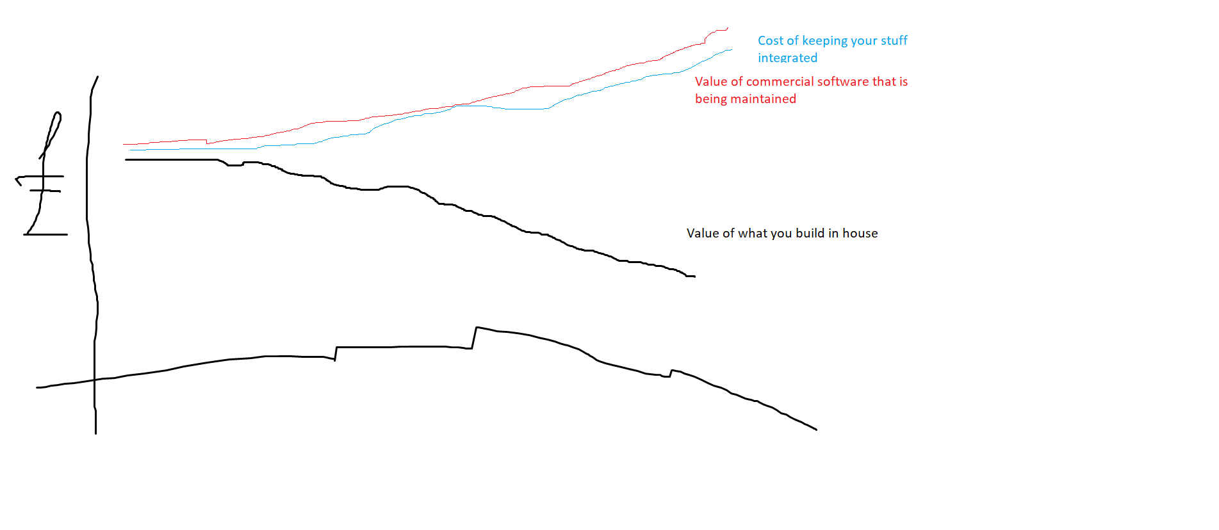
Make vs Buy things to keep in mind
It is a perennial problem at the CIO level to maintain an integrated and coherent application portfolio.
The cost of building incremental functionality might seem small, but:
Integration Costs Now
Maintenance Costs over time
Integration Costs over time
Increased points of failure
Costs in upgrade of COTS
Who maintains it? No-one likes to work on old inhouse code

Slide 12
The Acquisition Alternatives
Packaged vs Custom Build
XaaS vs On Premise
Inhouse vs Outsourced
Open Source vs Proprietary
Best of Breed vs Least Cost
Longstanding vs Latest Technology
Fixed Price vs Time and Materials Based

Slide 13
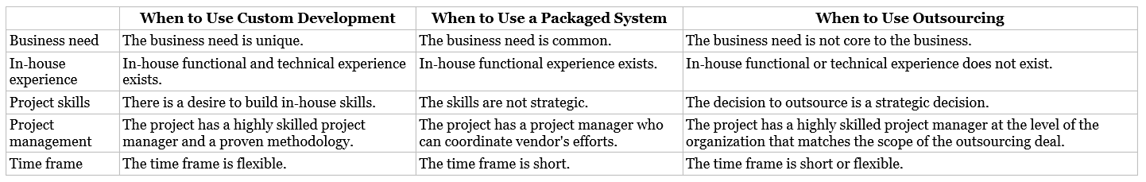
Influences on the Acquisition Strategy

Slide 14
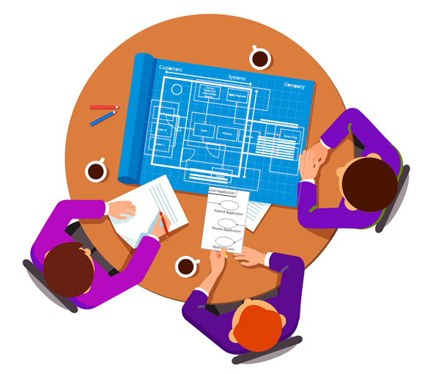
Analysing the Requirements
The project team carefully considers the nonfunctional business requirements that were identified during analysis.
The nonfunctional business requirements influence the system requirements that drive the design of the system's architecture.
Major considerations of the “how” of a system are operational, performance, security, cultural, and political in nature.
The team needs to create a secure system by specifying access restrictions and by identifying the need for encryption, authentication, and virus control.

Slide 15
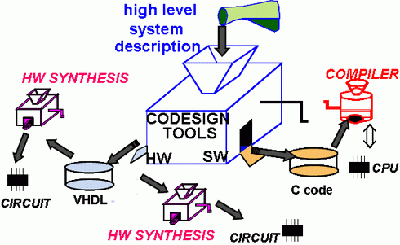
Hardware and Software specification
At the same time, architecture decisions are made regarding the hardware and software that will be purchased to support the new system.
These decisions are documented in the hardware and software specification, which is a document that describes what hardware and software are needed to support the new application.
The actual acquisition of hardware and software is sometimes the responsibility of the purchasing department or the area in the organization that handles capital procurement;
The project team uses the hardware and software specification to communicate the hardware and software needs to the appropriate people.

Slide 16
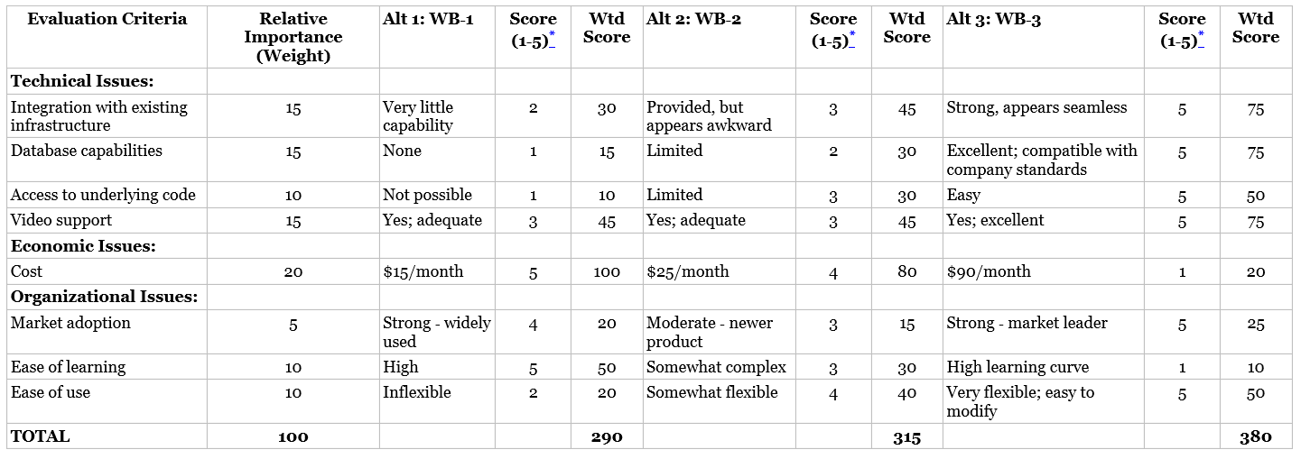
Alternatives Matrix
When you have gathered alternatives you have to evaluate them against a common set of weighted criteria to determine your best choice.

Slide 17
Nigel’s Software Selection Services
One of the services that SSTC Ltd offers is in software sourcing. Many smaller companies may not even be aware of software that is available, so we help them review the market.
Business Process | Business Process Analysis | Software Procurement Questionnaire | Software Solution Sourcing | Software Development Specification | Software Development | Software Acceptance Test Plan
 | Client tells us processes that are important. | Source Commercial Off the Shelf Software (COTS) | Source Commercial Off the Shelf Software (COTS) | Source Software Development | Do software Development | Confirm software is working to Specification
For Each Process | A high level Swim Lane Flow Diagram and Report that describes each box and decision in the flow. | A questionnaire that can be sent to prospective suppliers for them to confirm they have a solution. | Managing the selection process, scoring responses, creating a shortlist, organizing a demo, selecting winner. | A specification for software development. A set of function points and requirements. A set of conceptual prototype UI's and Report specifications. | Develop the solution according to the software specification, user documentation and installation documentation if and as appropriate, unit and system tests and test automation. | Develop an acceptance test plan to confirm that the requested functionality is delivered
Deliverable | Process Diagram Request for Information (RFI) | Request for Proposal (RFP) Invitation to Tender (ITT) | Demo Script | Specification | Design Doc User Doc Test Doc | Test Plan

Slide 18
Case Study – Sports Marketing Company
Process Diagram
Conceptual Prototype
Functional Specification
Make or Buy?
Technical Approach Document
Proof of concept demo

Slide 19
Terms used in the Purchasing cycle
Request for Information (RFI)
Response = Data Sheet, Brochure
Request for Proposal (RFP)
Response = Proposal Document
Uncertainties = High
Acquisition Cycle = Long
Invitation to Tender (ITT)
Response = Tender Document ~= Proposal Document
Request for Quote (RFQ)
Response = Quote
Uncertainties = Low
Acquisition Cycle = Short

Slide 20
Using components within your code base
It is not just the whole project that you need to consider.
You may be able to leverage other components within your project.

Slide 21
Nigel’s View on Using Embedded Components
Functional Area | Proprietary | Open Source
Single Sign On | Ping Idenity offers 32 different authentication methods for maximum convenience, while evaluating 36 different context, device and risk signals to help you create extraordinary experiences that balance security and convenience. | Shibboleth is an open-source project that provides Single Sign-On capabilities and allows sites to make informed authorization decisions for individual access of protected online resources in a privacy-preserving manner.

Slide 22
Nigel’s View on Using Embedded Components
Functional Area | Proprietary | Open Source
Document Management | OpenText™ Documentum™ offers a broad set of capabilities to manage and extract value from content of all kinds. Its industry-leading enterprise content services allows organizations to establish control of information with a single source of the truth, simplifying access to the most recent, approved business content. | PHP based open source document management system; the Seeddms supports MySQL and sqlite3 databases. It is an enterprise-ready document scanning software which is used for sharing as well as storing documents. It adapts comfortably according to the screen size, whether you use a smartphone or a desktop.

Slide 23
Nigel’s View on Using Embedded Components
Functional Area | Proprietary | Open Source
Reporting | Tableau is a visual analytics platform transforming the way we use data to solve problems – empowering people and organisations to make the most of their data. | JasperReports Server is a stand-alone and embeddable reporting server. It provides reporting and analytics that can be embedded into a web or mobile application as well as operate as a central information hub for the enterprise by delivering information on a real-time or scheduled basis to the browser, mobile device, or email inbox in a variety of file formats.

Slide 24
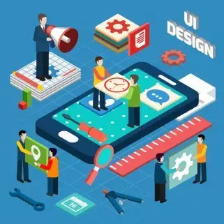
User interaction
The user's interactions with the system also must be designed.
The system inputs and outputs will be designed along with a plan or roadmap of the way the system's features will be navigated.
Design decisions made regarding the interface are communicated through the design document called the interface design.

Slide 25
Transition from Requirements to Design
Program specifications are prepared to provide the final design details and ensure that programmers have sufficient information to build the right system efficiently.
The program design document contains all of the information about the new system's programs.
The data component of the system, described in the logical data model, also must be designed prior to implementation.
Design decisions regarding data storage are written up in the data storage design document.

Slide 26
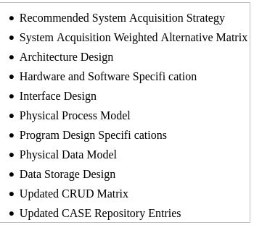
System specification outline
Some of these sections are in our first deliverable and some of them are in the second. Others are not relevant to us.

Slide 27
Next Lecture
Architecture Design

